Slide 1


Cognitive Strategy Routine
Grades 6-12
Notes:
Introduce self and welcome participants.
Let’s begin by reviewing the materials you need for this training.
(Hold items up as you talk.)
Say: You will have two sets of handouts. You will have a PowerPoint Presentation Handout and Additional Handouts. You will also need the blue and white Cognitive Strategy Routine card. As part of this training, you will also receive a poster set for all of the cognitive strategies. We won’t need the posters during the training, but you will each have a set for your classroom in both English and Spanish.

Slide 2
Jamika’s Story
CPQ: How does Jamika’s story shape your view of comprehension instruction?
Handout
#1
Notes:
Say: We begin our session today with an excerpt from Ellin Oliver Keene’s book, To Understand: New Horizons in Reading Comprehension (pp. 2-3).
Click for Comprehension Purpose Question (CPQ) and handout note to appear.
Say: Consider the CPQ as you listen in on a conversation between Mrs. Keene, a reading expert who is consulting in an elementary classroom, and Jamika, a student who has a very direct question for Mrs. Keene.
Present Jamika’s Story in Readers’ Theatre format.

Slide 3

How does Jamika’s story shape your view of comprehension instruction?
Think
Turn
Talk
Notes:
Say: Think for a moment. . .How does Jamika’s story shape your view of comprehension instruction? (Pause 3-5 seconds.) Now, turn and talk with a partner at your table.
After a brief partner discussion say: Think about Jamika’s story as we work through this session today. We will come back to it at the end of the module.

Slide 4
Goals for this Training
Reflect on the importance of comprehension instruction
Discuss the cognitive strategies good readers use to comprehend
Learn a routine for explicit instruction of these cognitive strategies
Notes:
Say: Let’s consider our goals for this training.
Read first two bullets.
Say: We will complete an activity today to guide us to be aware of the cognitive strategies we use to comprehend.
Read third bullet.
Say: The strategies that each of us use to comprehend while reading are the same cognitive strategies that we will explicitly teach our students. Instruction in comprehension should occur every day. During this P.D. we will explore a routine, outlined as a specific series of steps, that we can use to enhance our comprehension instruction.

Slide 5
Comprehension?
Why Should we Teach
Notes:
Say: So now let’s take a look at some reasons which support the systematic, explicit instruction of comprehension strategies.

Slide 6

Why Should we Teach Comprehension?
Think about your data.
  What does your data indicate regarding student comprehension?
Notes:
Read slide. Encourage participants to popcorn out their thoughts.
Say: Regardless, of what data we look at, BOY, MOY, EOC or STAAR, we likely can agree that we would desire that all of our students be developed and experiencing success in the areas of listening and reading comprehension. In fact, we likely feel a sense of urgency in helping students to improve their comprehension. We know that as text becomes more and more complex, it becomes more difficult to comprehend. It is critical that our students have specific strategies and routines to support their comprehension.
Today, we will examine a specific eight-step routine that can be used across grade levels to support and increase comprehension for our students.

Slide 7
Why Should we Teach Comprehension?
Durkin, 1978-79; RAND, 2000; Taylor, Pearson, Clark & Walpole, 1999; Taylor, Peterson, Pearson & Rodriguez, 2002
Notes:
Say: We have discussed the urgency of continuing a focus on comprehension instruction. This focus will require time. Yet research shows that, often, time is one of our challenges.
Let’s look at this graph. What does this information tell us? (Pause)
In the late 1970s, research by Delores Durkin revealed that of the 4,469 minutes of reading instruction she and her colleagues observed in elementary classrooms, only 28 minutes — less than 1% instructional time — was dedicated to comprehension instruction (Durkin, 1978-79). Keep in mind that other comprehension activities might have been taking place, such as asking students assessment questions, but that would not be considered instruction.
More recent research studies suggest that not much has changed; explicit comprehension instruction is still not adequate.
This research has implications for middle and high school. We cannot make assumptions that our students will be well equipped to use the strategies and skills they’ll need to comprehend the complex texts we use in middle and high school. In fact, research on comprehension tells us that we need to continue comprehension instruction for several years.
(RAND Reading Study Group, 2002; Taylor, Pearson, Clark & Walpole, 1999; Taylor, Peterson, Pearson & Rodriguez, 2002).

Slide 8
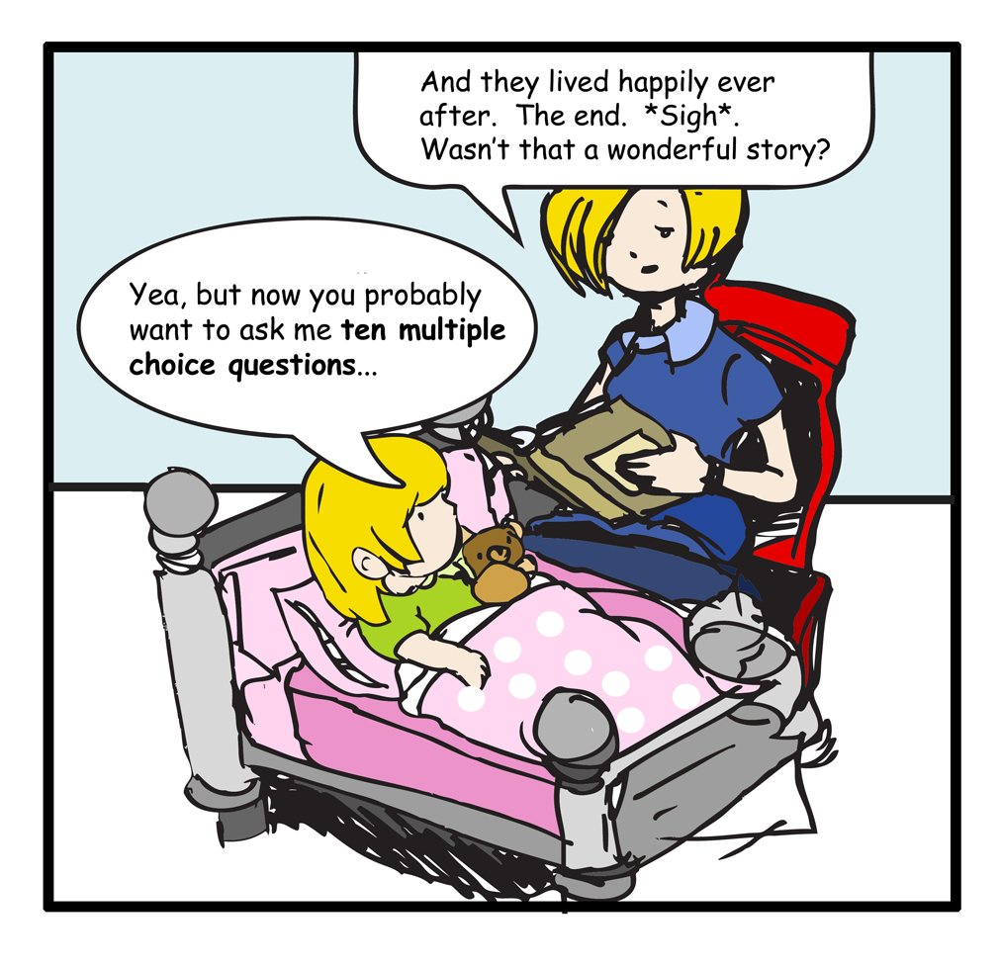
Cartoon by Bang Pham, 2008
Notes:
Read cartoon.
Say: Why is this cartoon funny?
Ask a participant to explain.
Say: Right, this little girl is so used to answering questions after reading that it has become an expectation for her. Historically this is how we’ve taught comprehension. Students read or listen to an assigned piece, and we ask questions at the end to assess how well they comprehend. We may even follow up this task by placing a number in our grade books.
Without direct, explicit, systematic comprehension instruction, this picture will not change. High quality instruction has the most potential for changing student outcomes (Durkin, 1978-79; NRP, 2000 as cited in VGCRLA, 2008).

Slide 9
Can we Teach Comprehension?
Researchers Duke and Pearson say:
The answer is a resounding
yes!
Notes:
Say: Given knowledge about what good readers do when they read, researchers and educators have addressed the following question: Can we teach students to engage in these productive behaviors? (Duke & Pearson, 2002, p. 206).
Click for text to appear. Read slide.
Say: A large volume of work indicates that we can help students acquire the strategies and processes used by good readers – and that this improves their overall comprehension of text, both the texts used to teach the strategies and texts they read on their own in the future” (Duke & Pearson, 2002, p.206). Also, “there is strong evidence that instruction specifically targeting reading comprehension is associated with positive outcomes regardless of the source of difficulty, even in children with decoding problems. (Fletcher, Lyon, Fuchs, & Barnes, 2007, p. 201).

Slide 10
Comprehension Instruction Should be
direct,
        explicit, and
                systematic.
Notes:
Read slide.
Say: Comprehension should be directly taught to students in a clear, step-by-step manner. Research on students with learning disabilities has found that these students experience difficulty with comprehension because they fail to “discover” strategies (Coyne, Chard, Zipoli, & Ruby, 2007). “Comprehension can be taught. Teacher-directed, overt, and explicit teaching of comprehension is possible and is effective, in all grades” (Moats, 2005, p. 9).

Slide 11

English Language Learners
Improving comprehension instruction for ELLs includes:
Instructional routines.
Explicit and direct explanations of strategies.
Modeling and think-alouds.
Teaching useful linguistics structures.
Providing high levels of support by scaffolding learning before, during, and after reading.
Providing opportunities for structured practice.
(Francis, Rivera, Lesaux, Kieffer, & Rivera, 2006; Dresler 7 Kamil, 2006; Genesee, Geva, Dressler, & Kamil, 2006; Lesaux, Lipka, & Siegle, 2006; Roit, 2006.)
Notes:
Say: Reading comprehension is also an area of difficulty for English Language Learners. We can help ELLs learn strategies that enable them to comprehend what they read.
Read slide.

Slide 12
English Language Learners
Improving comprehension instruction for ELLs includes:
Actively engaging students in monitoring, carefully selecting strategies, and reflecting on use of strategies.
Helping students to understand how to adjust for the type of text being read, the purpose for the reading, and the format of the content.
Alignment of comprehension instruction across the curriculum so students have opportunities to transfer and adapt strategies to new contexts.
(Francis, Rivera, Lesaux, Kieffer, & Rivera, 2006; Dresler 7 Kamil, 2006; Genesee, Geva, Dressler, & Kamil, 2006; Lesaux, Lipka, & Siegle, 2006; Roit, 2006.)
Notes:
Read slide.

Slide 13
To put it Another way …
“Good comprehension instruction includes both explicit instruction in specific comprehension strategies and a great deal of time and opportunity for actual reading, writing, and discussion of text” (Duke & Pearson, 2002, p. 207).
Notes:
Read slide.
Say: What should good comprehension instruction include? Reread this quotation and highlight two or three words that really stand out to you. When you’ve finished, share the words you highlighted with a partner, and tell them why you thought they were important.
Give participants one or two minutes to complete.
Say: These are the words that stood out for me.
Say: Our instruction must be explicit.
Click to highlight the word explicit.
Say: We teach the specific comprehension strategies that research has shown to be used by proficient readers.
Click to highlight the word specific.
Say: And our instruction must allow our students the opportunity to apply what they’ve learned through their own reading, writing, and discussion.
Click to highlight the word opportunity.

Slide 14
What cognitive strategies do Proficient readers use?
Notes:
Say: Consider: What cognitive strategies do proficient readers use?

Slide 15
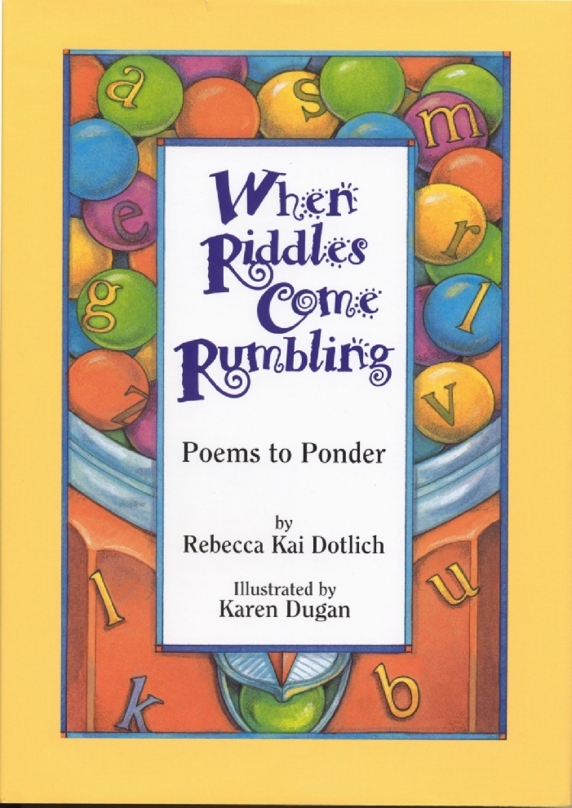
Notes:
Say: Today, we will complete an activity that will lead us to identify the strategies proficient readers use. Because we always work from support to independence, I will model what you will be asked to do. I will do a think-aloud for you and then you will have a chance to record some of your thinking. I will use a riddle from this book to model the cognitive strategies I use while reading. Then, you will use another riddle to discover the cognitive strategies you use.

Slide 16
Comprehension Purpose Question
What might this riddle be about?
Notes:
Say: As you know, it is essential to have a purpose for reading. Today, we will present purposes for reading in the form of Comprehension Purpose Questions, or CPQs.
In this example, we will focus our attention on trying to figure out what this riddle might be about.
Read slide.

Slide 17

tossing kids up in the air
Is it summer? Chinook?
it’s outside
bouncing…
jump + bounce = jouncing
everywhere…lots of fun
gymnastics?
I send you flying in the air,
warm wind whistling
through your hair;
you’re jumping, jouncing,
all around;
somersaulting,
Notes:
NOTE TO PRESENTER: PRESENT THIS RIDDLE AS A THINK-ALOUD. PARTICIPANTS WILL USE ANOTHER RIDDLE (ABOUT THE TREE) TO TRACK THEIR THINKING.
Say: In this demonstration, the riddle will appear line by line on the left. In a real reading situation, we would not cover up the text and reveal it line-by-line, but in this case, I want to slow down my thinking so that I can model the processes I use as I read. On the right side of the screen, I will uncover the thinking I did as I was trying to figure out the riddle. You will get a chance to track your own thinking in a similar manner following my demonstration.
Click once for each line to appear. The riddle will appear on the left side of the screen. Read the riddle aloud. Pause to share your authentic thinking after the line appears. Jot notes of your authentic thinking should appear on the right side of the screen adjacent to the line in the riddle you are referring to.
Sample script requires 17 clicks.
Text: I send you flying in the air…
Say: That reminds me of how I would throw my kids up in the air when they were little. I would toss them up (enact how that might look), and catch them. I can hear them laughing and I can see how their faces would light up.
Text: warm wind whistling…
Say: Warm wind? Is it summer? Is it a Chinook?
Text: through your hair…
Say: Okay. It must be outside if there is wind whistling through your hair. It makes me think about those shampoo commercials. I can see the girl standing on top of a grassy hill wearing a long flowered dress. Her long brown, wavy hair is blowing in the wind. I wish I had hair like that.
Text: you’re jumping, jouncing…
Say: Jouncing? That must be like bouncing. It’s like they put jump and bounce together and came up with jouncing.
Text: all around…
Say: So it’s everywhere. It sounds like it is lots of fun!
Text: ...somersaulting…
Say: Like in gymnastics? There are some other words that sound like gymnastic words. Jumping, jouncing and flying. But wait, it’s outside. Gymnastics doesn’t happen outside.
Say: Think for a moment. What might this riddle be about?

Slide 18
Your Turn…
  Cover up the riddle
  Read the riddle independently
  Reveal ONE line at a time and record your own thinking
  When you are done, quietly share your thinking with a neighbor
  CPQ:
  What might this riddle be about?
Notes:
NOTE TO PRESENTER: FOR THIS ACTIVITY, USE THE “TREE” POEM. HAND OUT COPIES OF THE POEM/RIDDLE AFTER GOING THROUGH THE BULLETS ON THE SLIDE.
Say: Now it is your turn to track your thinking. The purpose of this activity is to become aware of the cognitive strategies we use while reading. It is not to find the correct answer to the riddle.
Click for first bullet to appear. Read bullet.
Click for second bullet to appear. Read bullet.
Say: Please take out a piece of scrap paper that you will be able to use to cover up the riddle.
Click for third bullet to appear. Read bullet.
Say: This step is important. It will help you to be aware of your thinking.
Click for fourth bullet to appear. Read bullet.
Click for fifth bullet to appear. Read bullet.
Reinforce with participants that they can do the same kinds of things that you did in the think-aloud. They might:
· record questions
· draw pictures
· highlight or underline words
Hand out a copy of the riddle.
Give participants 4 -5 minutes to complete.

Slide 19
What cognitive strategies did you use while reading the riddle?
Notes:
Say: Before we check our CPQ, let’s reflect on the cognitive strategies we used while reading the riddle.
I will share my thinking with you from the first poem I read, and then you will have time to reflect on your own thinking using the second poem.

Slide 20
tossing kids up in the air
Is it summer? Chinook?
it’s outside
bouncing…
jump + bounce = jouncing
everywhere…lots of fun
gymnastics?
Making Connections
I send you flying in the air,
warm wind whistling
through your hair;
you’re jumping, jouncing,
all around;
somersaulting,
Notes:
NOTE TO PRESENTER: YOU WILL BE MODELING YOUR THINKING THROUGH THE FIRST POEM, WHICH IS IN THE BACKGROUND ON THE SLIDE. THE HIGHLIGHTED PARTS ARE FROM YOUR INITIAL READING OF THE POEM.
Say: Many of us probably made connections as we tried to figure out this riddle. We connect to our background knowledge to help us understand. We make connections to things that have happened to us, and we make connections to other texts such as books, television shows, movies, video games, paintings, etc. (Wilhelm, 2004).
Click for riddle to appear and for the title to animate to the bottom corner of the slide.
Sample script:
Say: In the example, I shared with you a couple of connections that I was making. The first line reminded me of tossing my children in the air when they were little. Another connection I made was to the warm wind whistling. This reminded me of the Chinooks I would experience where I grew up.
Many of you might be wondering what a Chinook is. A Chinook is a warm wind that comes at the end of winter and brings the first hint of spring. I am from the Northwest. A Chinook is part of my background knowledge. This is important to note. Each reader brings different background knowledge to a reading situation. Because of this, we must value and encourage students’ independent thinking as they work with the text. We also build our students’ background knowledge so they have the tools they need to understand text (Marzano, 2004; Risko & Walker-Dalhouse, 2007).
Note to presenter: Make the think-aloud about the Chinook work for you. You may role-play the think-aloud, assuming the role of someone who either is from the Northwest or has recently been on a trip to the Northwest.

Slide 21
Making Connections
Reflect on your thinking.
Did you make connections while reading?
Think
Notes:
Read slide. Give participants a few moments to reflect on their thinking USING THE “TREE” POEM.

Slide 22

tossing kids up in the air
Is it summer? Chinook?
it’s outside
bouncing…
jump + bounce = jouncing
everywhere…lots of fun
gymnastics?
I send you flying in the air,
warm wind whistling
through your hair;
you’re jumping, jouncing,
all around;
somersaulting,
Creating Mental Images
Notes:
Say: Have you ever had that feeling of being lost in a book? That’s probably because you were creating mental images while reading. Often, this seems like something that we do naturally, but not all readers create mental images as they read. Helping students to visualize strengthens comprehension and is helpful in all subject areas (Gambrell & Brooks Jawitz, 1993; Wilhelm, 2004).
This strategy ties back to our first strategy, making connections. When creating mental images, you are most likely making connections to something that you know.
Mental imagery is more than just pictures in your head. It includes all of the five senses — not just how something looks, but also how something smells, feels, tastes and sounds. Mental images change as we read. That’s why sometimes we say that mental images are like “movies in your mind” rather than pictures. They change the way the frames in a movie change (Keene & Zimmermann, 2007).
Click for riddle to appear and for the title to animate to the bottom corner of the slide.
Sample script:
Say: In my think-aloud, I shared with you some of the mental images I was making. Again, in the first line, not only did I make the connection of throwing my kids in the air, but I could really see and hear that in my head. You may have noticed that I even pantomimed throwing them in the air, and I could also remember how heavy they felt when I caught them.
I was creating mental images when I thought about the “wind whistling through your hair,” as I described what the girl on the hill with the long hair looked like.

Slide 23

Creating Mental Images
Reflect on your thinking.
Did you create mental images while reading?
Think
Notes:
Read slide. Give participants a few moments to reflect on their thinking, AGAIN USING THE “TREE” POEM.

Slide 24
tossing kids up in the air
Is it summer? Chinook?
it’s outside
bouncing…
jump + bounce = jouncing
everywhere…lots of fun
gymnastics?
I send you flying in the air,
warm wind whistling
through your hair;
you’re jumping, jouncing,
all around;
somersaulting,
Asking & Answering Questions
Notes:
Say: The next strategy is asking & answering questions.
In my experience, it seems as though older students tend to ask fewer and fewer questions during reading. Do you find that ,too? Is it because they learn not to interrupt while an adult is reading? Is it because they realize that the teacher’s questions are more important than their own? Is it because they have learned that they will have 10 questions to answer at the end of the reading, so why bother asking their own? Think back to the cartoon. The little girl expected her mom to question her at the end of the story. She didn’t ask her mom questions about the story or even share in her mom’s appreciation of the story.
Good readers ask questions to help clarify information, to probe deeper into the text, and as a precursor to making an inference. Asking questions helps keep the reader engaged (Harvey & Goudvis, 2000; Klinger, Vaughn & Boardman, 2007).
Click for riddle to appear and for the title to animate to the bottom corner of the slide.
Sample script:
Say: In my think-aloud, I shared with you some of the questions I was asking. I wondered, was it summer? Was it a Chinook? Was the riddle about gymnastics?

Slide 25
Asking & Answering Questions
Reflect on your thinking.
Did you ask and answer questions while reading?
Think
Notes:
Read slide. Give participants a few moments to reflect on their thinking.

Slide 26
Making Inferences & Predictions
tossing kids up in the air
Is it summer? Chinook?
it’s outside
bouncing…
jump + bounce = jouncing
everywhere…lots of fun
gymnastics?
I send you flying in the air,
warm wind whistling
through your hair;
you’re jumping, jouncing,
all around;
somersaulting,
Notes:
Say: Good readers also make inferences and predictions. We make inferences when we take clues from the text and integrate them with our background knowledge to fill in information not directly given to us by the author. We also make inferences to figure out unknown words and to help us predict what might happen next. Authors simply can’t include every detail in their writing. They expect the reader to understand some things on their own (Keene & Zimmermann, 1997; Miller, 2002).
Click for riddle to appear and for the title to animate to the bottom corner of the slide.
Sample script:
Say: In my example, I shared with you some of the inferences and predictions I was making. I used the clues to infer that the activity in the riddle was outside and was lots of fun. I figured this out from the words “wind blowing/whistling through your hair,” and “jumping and somersaulting.” In my experience these words describe fun pastimes. I also inferred the meaning of the word jouncing from the context. Not only did I make a connection to a word that was familiar — bouncing — but I also used the context to infer meaning of new vocabulary.

Slide 27
Making Inferences & Predictions
Reflect on your thinking.
Did you make inferences and predictions while reading?
Think
Notes:
Read slide. Give participants a few moments to reflect on their thinking.

Slide 28

tossing kids up in the air
Is it summer? Chinook?
it’s outside
bouncing…
jump + bounce = jouncing
everywhere…lots of fun
gymnastics?
Determining Importance & Summarizing
I send you flying in the air,
warm wind whistling
through your hair;
you’re jumping, jouncing,
all around;
somersaulting,
Notes:
Say: Determining importance and summarizing is another strategy that good readers use. Good readers think about their purpose for reading and that helps them to determine what information is important to attend to closely. In order to summarize, a reader must be able to pick out key ideas and put them together in a succinct way (Klinger, Vaughn & Boardman, 2007; NRP, 2000).
Click for riddle to appear and for the title to animate to the bottom corner of the slide.
Sample script:
Say: In my think-aloud, I tried to determine what information might be important in helping me solve the riddle. I saw a theme in some of the words. I highlighted those important words – flying, jumping, jouncing, and somersaulting. I then pulled all of this information together to predict that the riddle may be about gymnastics. If I summarized what I read, I might say that the riddle is about a fun, outdoor activity.

Slide 29

Determining Importance & Summarizing
Reflect on your thinking.
Did you determine importance and summarize while reading?
Think
Notes:
Read slide. Give participants a few moments to reflect on their thinking.

Slide 30
tossing kids up in the air
Is it summer? Chinook?
it’s outside
bouncing…
jump + bounce = jouncing
everywhere…lots of fun
gymnastics?
Monitoring & Clarifying
I send you flying in the air,
warm wind whistling
through your hair;
you’re jumping, jouncing,
all around;
somersaulting,
Notes:
Say: The last strategy we want to discuss is monitoring and clarifying. Readers who are good at monitoring their comprehension know when they understand what they read and when they do not. Monitoring and clarifying provide a foundation for the other strategies – they tell us when it’s time to employ a strategy to “fix-up” our understanding (Fletcher, Lyon, Fuchs, & Barnes, 2007; Snow, Burns & Griffin, 1998; Tovani, 2000).
Our goal, then, is to help students be aware of what they do understand and what they don’t. To do this, we ask students to share their thinking with us and explain why they think what they do (metacognition).
Click for riddle to appear and for the title to animate to the bottom corner of the slide.
Sample script:
Say: In my think-aloud, I thought that the piece might be about gymnastics. Then I reread and thought about the information that did not fit with my prediction. I was pretty sure that the riddle was about something outside because of the warm wind blowing. That information helped me realize that likely, the riddle wasn’t about gymnastics, which usually occurs inside. But hmmm, I think that I was on the right track…

Slide 31
Monitoring & Clarifying
Reflect on your thinking.
Did you monitor and clarify while reading?
Think
Notes:
Read slide. Give participants a few moments to reflect on their thinking.

Slide 32
What might this riddle be about?
Notes:
NOTE TO PRESENTER: THE INITIAL POEM WAS ABOUT A TRAMPOLINE. THE POEM WHICH THE PARTICIPANTS USED REPRESENTS A TREE.
Say: Remember, the goal of this activity was not to find the correct answer to the riddle. This exercise was to help us “uncover” the strategies that we tend to rely on while reading.
Of course, we always check our CPQ after reading. Our CPQ was “What might this riddle be about?”.
Does anyone think that they have figured out the riddle?
Select 2-3 participants to share. Thank them for sharing and ask them to explain their thinking by asking, “Why do you think that?” or, “What led you to that conclusion?”

Slide 33

I quietly dance
As the warm wind blows,
Reaching my arms high up to the sky,
Soaking up blessings from the heavens above.
I stretch to stand
straight
and
tall,
Anchored safely to the ground.
I am radiant and strong,
As you find refuge in my shadow.
Notes:
Say: Once again, the goal of this activity was not to find the correct answer to the riddle. This exercise was to help us “uncover” the strategies that we tend to rely on while reading.
However, the author of the riddle said that the poem was about (CLICK) a tree.

Slide 34


Cognitive Strategies
Making Inferences & Predictions
Determining Importance & Summarizing
Monitoring & Clarifying
Making Connections
Asking & Answering Questions
Creating Mental Images
Notes:
Say: Here are the cognitive strategies that we just discussed. You will notice that we have highlighted 6 thinking processes that proficient readers use. “…[E]ffective readers actually use a small repertoire of strategies…. For students to acquire such skills to the point of internalization probably requires several years of instruction and scaffolded use, although comprehension gains should be quite pronounced even during the first year (Brown et al., 1996; Pressley et al., 1992). Yes, we have a vision of what it takes to create strategic elementary readers” (Pressley, April 2006, p. 18).
Say: Here are the cognitive strategies that we just discussed. You will notice that we have highlighted 6 thinking processes that proficient readers use. “…[E]ffective readers actually use a small repertoire of strategies…. For students to acquire such skills to the point of internalization probably requires several years of instruction and scaffolded use, although comprehension gains should be quite pronounced even during the first year (Brown et al.,1996; Pressley et al., 1992). Yes, we have a vision of what it takes to create strategic
elementary readers” (Pressley, April 2006, p. 18).

Slide 35
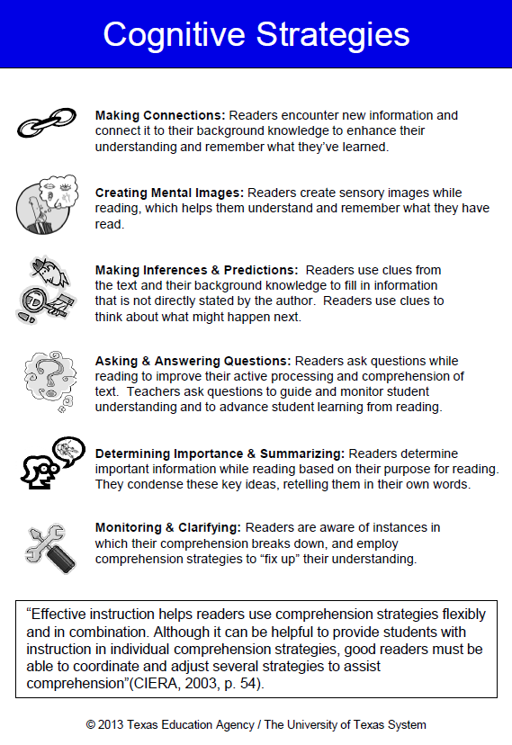
Cognitive Strategies…
Reflect on the activity
  Which strategy did you tend to rely on the most?
Share your thinking with a partner
  How does reflecting on your own strategy use help you to think about comprehension instruction?
Notes:
Say: Look down through the notes which recorded your thoughts about the poem and the cognitive strategies you used to comprehend the text. Which strategy did you tend to rely on the most?
Say: Turn and talk with your partner about your findings. How does reflecting on your own strategy use help you to think about comprehension instruction?

Slide 36
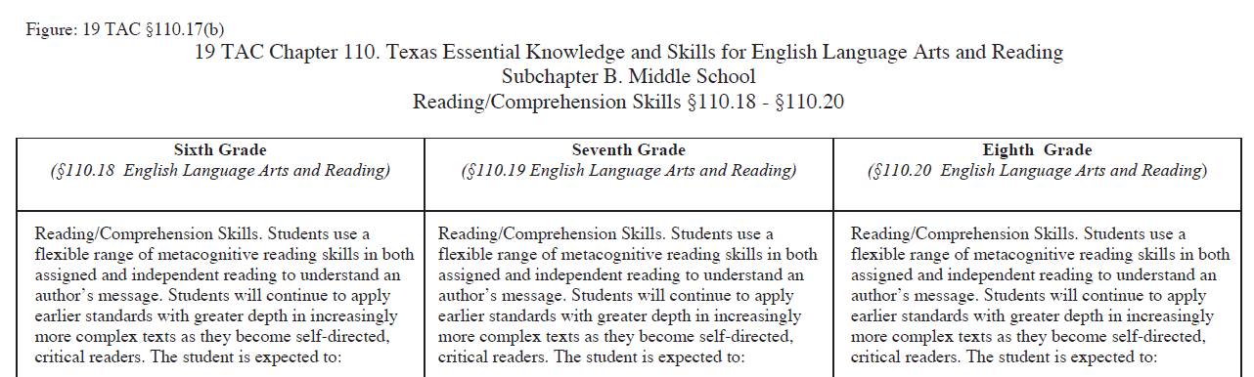
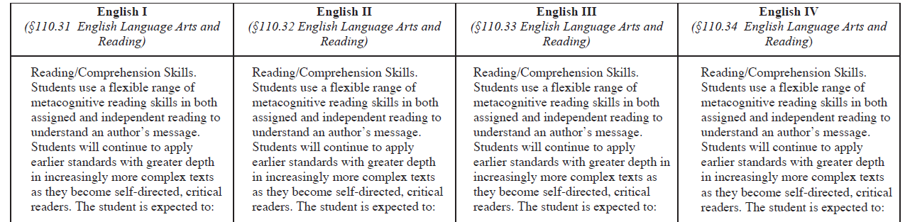
Framework for Instruction to
Teach the ELAR/SLAR TEKS
Handout #2
Cognitive Strategy Routine
Notes:
Say: As we reflect upon our own strategy use, we can see how important it is to ensure that our instruction focuses on ALL of the cognitive strategies that proficient readers use. Our ELAR and SLAR TEKS reinforce this notion as it outlines student expectations in the area of comprehension.
This is Figure 19. It is part of the comprehension ELAR/SLAR TEKS.
Let’s focus on the student expectations for seventh grade as a way to frame our discussion.
CLICK
Say: Students use a flexible range of metacognitive skills. We introduce our students to the various strategies through direct, explicit, systematic instruction following the cognitive strategy routine.

Slide 37
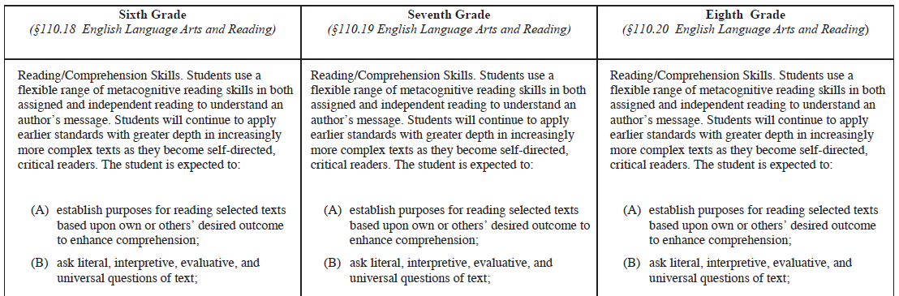
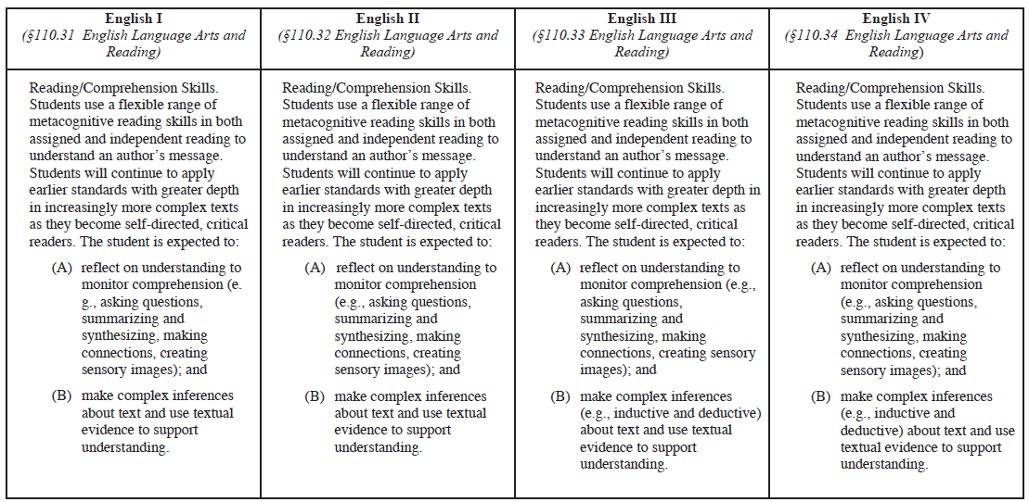
Reading With Purpose
Asking Questions
Notes:
Say: Student expectation A
CLICK
Say: …establish purposes for reading selected texts is addressed in our Reading With Purpose module.
Student expectation B…
CLICK
Say: …ask literal, interpretive, and evaluative questions of text is addressed in our Asking & Answering Questions module.

Slide 38
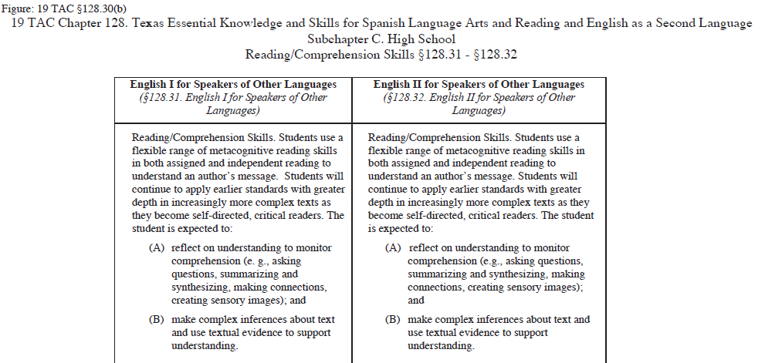
Asking Questions
Making Inferences
Notes:
SAY: Again our Spanish Language Arts and Reading and English as a Second Language TEKS reinforce this notion as it outlines student expectations in the area of comprehension.
And, B, Students are expected to make complex inferences about text as well.

Slide 39
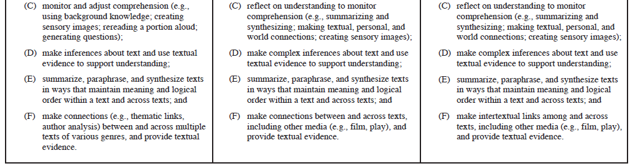
Determining Importance & Summarizing
Making Connections
Creating Mental Images
Making Inferences
Determining Importance & Summarizing
Making Connections
Notes:
Say: Student expectation C…
CLICK
Say: …explains that students are expected monitor and adjust comprehension by summarizing and synthesizing, which is addressed in our Determining Importance and Summarizing module.
CLICK
Say: Students also make connections, and
CLICK
Say: create sensory images …
CLICK
Say: Students are also expected to make inferences as stated in student expectation D
CLICK
Say: Summarize and paraphrase and
CLICK
Say: …make connections between and across texts.

Slide 40
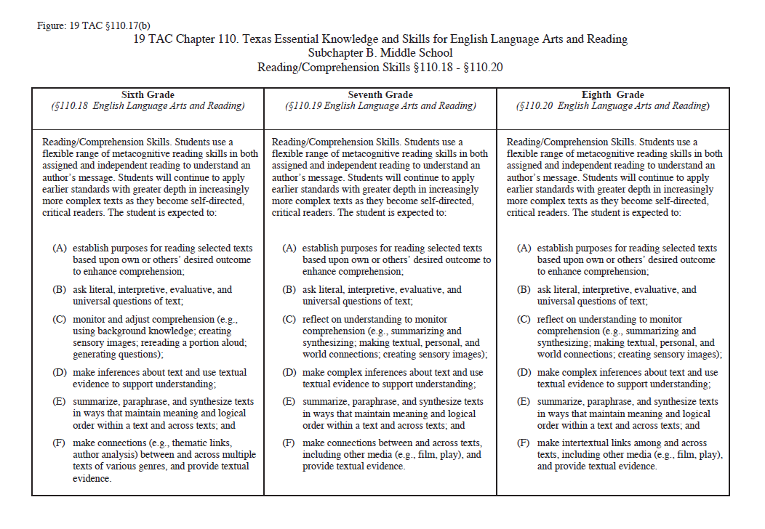

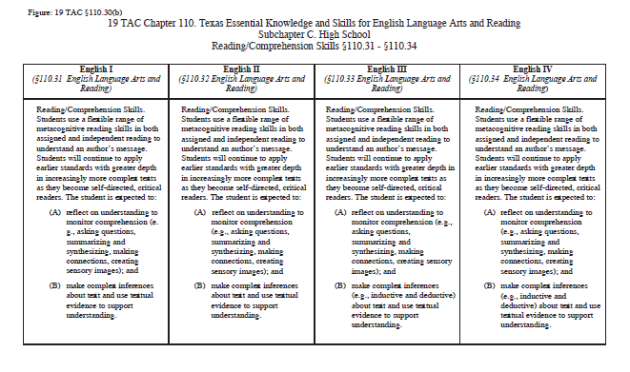

ELAR/SLAR
Figure 19
Notes:
Say: As you are aware, if it is an expectation from our state standards that we teach students these cognitive strategies, then we must also assess the use and understanding of these skills and strategies.

Slide 41

SB8 page 46
E4 page 48
Notes:
Say: Additionally, the comprehension strategies taught using this routine are also aligned to the TSLP.
Standards Based Instruction: page 46: SB8. Develop a campus-wide system for teaching academic vocabulary or words that influence achievement in multiple disciplines.
Effective Instructional Framework: page 48: E4. Increase student motivation and sustained engagement through quality instruction by recognizing that the knowledge students bring to learning is valued.
Let us now look at a routine for teaching these cognitive strategies effectively.

Slide 42
A Cognitive strategy routine
Notes:
Say: As with much of what we teach, cognitive strategy instruction can be embedded within a routine. A routine is a set of clear, systematic steps that we use each time we introduce or focus on a strategy in our instruction. This routine guides us to ensure that our instruction is effective and explicit.

Slide 43
Why Cognitive Strategies?
“The idea behind explicit instruction of text comprehension is that comprehension can be improved by teaching students to use specific cognitive strategies or to reason strategically when they encounter barriers to comprehension when reading” (NRP as cited in Torgesen, 2007).
Notes:
Say: Before we delve into the routine for teaching these strategies, we want to say a word about why we’re using the term cognitive strategies.
Read slide.
Say: The words “cognitive” and “cognition” refer to our thoughts and thought processes. We teach our students many ways of analyzing text, but today we’re focusing on those thinking processes that become automatic when we’re proficient readers. We make these strategies visible to our students. We achieve this through systematic, direct and explicit instruction.
The six strategies that we’ve talked about are sometimes called skills, strategies, or thinking processes.

Slide 44
Our Task
Handout
#3
Comprehension Purpose Question:
What do we need to do, as teachers, to make sure our students are proficient readers?
“Teachers should model and explain comprehension strategies, have their students practice using such strategies with teacher support, and let students know they are expected to continue using the strategies when reading on their own. Such teaching should occur across every school day, for as long as required to get all readers using the strategies independently – which means including it in reading instruction for years” (Pressley, 2001, p. 4).
Notes:
Say: Please read Handout 3 in your Additional Handouts packet. Our comprehension purpose question (CPQ) for this excerpt is, “What do we need to do, as teachers, to make sure our students are proficient readers?”
Provide time for participants to read.
When participants are finished reading, say: What are the important ideas in this quotation? Thinking about our CPQ - What do we need to do, as teachers, to make sure our students are proficient readers?
Use the Think-Turn-Talk routine to answer the CPQ.
Say: A study conducted by Duffy and colleagues (1987) found improvement with low achieving third grade readers when teachers explicitly explained the mental processing associated with using reading skills as strategies. They found that students were “(a) more aware of lesson content and of the need to be strategic when reading and (b) scored better on nontraditional, standardized, and maintenance measures of reading achievement” (Duffy et al., 1987, p. 347).

Slide 45
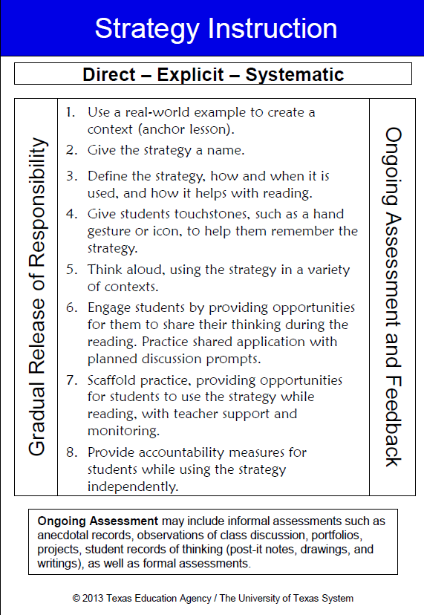
Cognitive Strategy Routine
Notes:
Say: During the remainder of the presentation, we will be referring to this blue-and-white card. This is the Cognitive Strategy Routine card.

Slide 46
Cognitive Strategy Instruction
Support
Ongoing Assessment and Feedback
Think-aloud
Shared Application
Scaffolded Practice
Independent Application
Independence
Notes:
Say: We’re going to be modeling a routine you can use to introduce these strategies to your students. It’s based on some of the ideas expressed in the quote we just read.
When we were learning to write lesson plans, we learned the mnemonic “I do, we do, you do,” to help us remember the sequence of steps – first I model for the students, then we all do it together, and then the students try it on their own.
Often with comprehension instruction, however, we skip the “I do” and “we do” steps and go right to the “you do,” by asking the students comprehension questions without modeling the strategies they could use to figure out the answers.
This simplified graphic is derived from the gradual release of responsibility model (Pearson & Gallagher, 1983; Au & Raphael, 1998 as cited in Duke & Pearson, 2002). It shows how we transition our students from support to independence. The arrow moves from a darker color to a lighter color. In our graphics today, the darker color will show the most supported steps (Adapted from Edmonton Public Schools, 2000; Elk Island Public Schools, 2001).
We begin by explaining the strategy and modeling through think-aloud. As teachers, we’re doing the comprehension work at this point.
Next, we share the application of the strategy. As a class, we practice the strategy together.
Third, we scaffold practice. Students practice while reading, while we provide strong support and guidance.
Last, students apply the strategy on their own.
Along the right side of the graphic, we see the words “Ongoing assessment and feedback.” This is crucial to our comprehension instruction. For example, I might move from the think-aloud stage to the shared application, but when my students share their thinking, I realize that they are struggling to use the strategy. So I might move back to the think-aloud stage.
This is a fluid process that must be guided by our observations and assessments. I also provide direct and corrective feedback to my students so they know whether or not they are using the strategies with facility.

Slide 47
Step 1
Use a real-world or familiar example to create a context.
Example:
I have a backpack here. I don’t know to whom it belongs. There is no name on it. Let’s be detectives and use our background knowledge and the clues inside the backpack to help us figure out to whom it belongs.
Notes:
Say: We are going to model eight steps for introducing a cognitive strategy.
Read heading.
Say: There are two purposes for introducing strategies to students through the use of an anchor lesson. First, we can help clarify what the strategies are by providing students with examples of how we use the strategy in familiar contexts. All of the cognitive strategies are used not only when we read, but in our daily lives. It is important that we know our students well and are familiar with their backgrounds and interests so we can choose anchor lessons that will have meaning to them. The second purpose for an anchor lesson, is to anchor the strategy in students’ memories. We can use the anchor lesson as a touchstone to refer to whenever we discuss the strategy. For example, we might say, “Remember when we made inferences when we tried to figure out to whom the backpack belonged to?”
An anchor lesson takes 15 to 20 minutes. We only teach one anchor lesson for each strategy. We usually teach the anchor lesson the day before we introduce using the strategy with text.
Let’s take a moment now to experience an anchor lesson for introducing making inferences to our students.
Bring in a sample backpack with the several items inside (see below for suggestions). Take one item out at a time. Show the “clue”. Think aloud or ask participants to infer something about the owner of the backpack from the clue. Follow up with the question, “What makes you think that?” to show how they use their background knowledge together with the clues to make an inference.
Sample Think-aloud:
Say: I have a backpack here. I don’t know to whom it belongs. There is no name on it. Let’s be detectives and use our background knowledge and the clues inside the backpack to help us figure out to whom it belongs. I notice that it has pink flowers on it. Let’s see what’s inside. (Pull out a tube of lip gloss). Lip gloss. It’s cherry flavor.
This backpack is similar to my daughter’s backpack. She also likes to wear lip gloss. This is information that’s in my background knowledge—my experience. I know that girls often have flowers on their backpacks and that they like to use lip gloss. Not many boys carry lip gloss in their backpacks. These clues, plus my background knowledge help me to infer that this backpack likely belongs to a girl. Would you all agree with my inference?
Continue in this manner. Pulling each clue out, one at a time. Identify the clue, share your background knowledge and the inference that you make or ask participants to share their thinking.
Clue: hair brush + a hair scrunchie
BGK: I know that many of you with long hair have brushes and scrunchies in your backpacks.
Inference: I’m inferring that the backpack belongs to someone who has long hair.
Clue: chapter book
BGK: When I flip through this book, I can see that the print is small and there are 250 pages in it. This looks like a book that a fourth or fifth grader might read.
Inference: I’m inferring that the backpack belongs to an older student.
Say: We were able to make some good inferences about the person who owns this backpack. Just like a detective, we looked at the clues and used our background knowledge to figure out some things.

Slide 48
Step 2
Give the strategy a name.
Example:
Today we are going to learn a comprehension strategy called “making inferences.”
Notes:
Say: The day after we teach the anchor lesson, we plan a lesson modeling for students how to use the strategy while reading text. We begin each daily strategy lesson with step 2.
Read heading.
Model the example in the box.
Say: We want to use clear and consistent language when referring to the cognitive strategies. Our comprehension strategy instruction is stronger if everyone in the school or district, from kindergarten to fifth grade, and from sixth grade to twelfth grade uses the same vocabulary to refer to the strategies we are teaching.
Background Knowledge for Presenter:
Students learning to read do not automatically learn cognitive strategies on their own—especially struggling readers; we therefore need to be explicit and consistent in teaching these strategies. “Teachers use language that is clear and consistent to reduce confusion and prevent misunderstanding” (Coyne, Chard, Zipoli, & Ruby, 2007, p.88).

Slide 49
Step 3
Define the strategy, how and when it is used, and how it helps with reading.
Example:
The strategy we’re talking about today is called “making inferences.” Sometimes the author doesn’t tell us everything, but leaves hints to help us figure things out. When we make inferences, we use clues from the text and our background knowledge to figure something out.
Notes:
Read heading.
Model the example in the box.
Say: Notice again, we are using very explicit language to describe the strategy.
Background Knowledge for Presenter:
“[E]xplicit instruction improves reading comprehension even in students for whom decoding and fluency is an issue” (Fletcher, Lyon, Fuchs, & Barnes, 2007, p. 199).
“In addition to the modeling and scaffolding… the teacher routinely reminds students of why these strategies are important and how they will help students in their reading” (Duke & Pearson, 2002, p. 227).

Slide 50

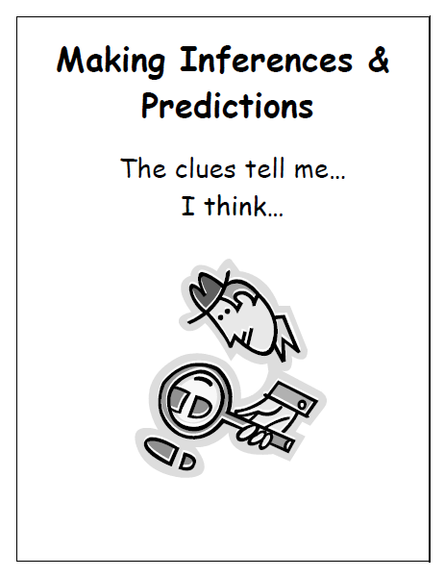
Step 4
Give students touchstones, such as a hand gesture or visual representation, to help them remember the strategy.
Examples:
Notes:
Read heading
Say: When first introducing a strategy, we need to give our students touchstones that will help them remember and understand a strategy. I want my students to value these touchstones, so I explain to them why I chose a specific graphic to represent the strategy.
Model: I have selected a picture of a detective to help us remember the strategy of making inferences and predictions. I chose a detective because he uses clues to figure things out. We also have a hand signal we use when making inferences and predictions. I hold my hand up close to my eye just like a detective would do if he were looking for a clue though his magnifying glass.
Say: We use the same graphics and gestures across all age/grade levels for consistency on our campus.
Background Knowledge for Presenter:
Asking students to gesture while they learn something new helps them to remember what they have learned (Cook, Mitchell, & Goldin-Meadow, 2007, Abstract). “Comprehension Process Motions can make abstract, metacognitive aspects of comprehension processes visible, understandable and accessible to young readers” (Block, Parris & Whiteley, 2008, p. 460).

Slide 51
Step 5
Handout
#4
Think aloud, using the strategy in a variety of contexts.
Example:
Hmm, I’m inferring that this boy is very responsible. He tells Mr. Crawford what he’s done without making excuses. That tells me a lot about his character. I know from my background knowledge, that when someone takes responsibility for what they’ve done, they ask what they can do to make it better. The author doesn’t tell us he’s responsible, but we can use the clues in the text and our background knowledge to infer that the boy is responsible.
Notes:
Say: Step 5 is where we think-aloud for students how we use the strategy to help us understand the text. Let me model for you how I might think-aloud the inferences I make when reading a short story about Abraham Lincoln. Please follow along on handout #4.
Our CPQ for this text is: What do we learn about Abraham Lincoln?
Read the first paragraph of the text then model the example in the box on the slide.
Read the second paragraph and stop where is says, “leaves and warped binding.” You may use the sample think-aloud provided below.
Sample think-aloud:
I’m inferring that the book got wet. It says that it was stained and warped. Warped means that the pages are wavy. I know this from my background knowledge. I’ve had books get wet before and the pages ended up warped.
Continue reading to the end of the paragraph.
Say: Ah, the author confirmed my inference. He didn’t directly tell us that the book got wet, but he gave us more information when he said that it had been left in the storm and asked why Abe left it out to soak.

Slide 52
Step 6
Engage students by providing meaningful opportunities for them to share their thinking during the reading. Practice shared application with planned discussion prompts.
Example:
Let’s think for a moment. Can you infer how young Abe feels about this book? How do you know that? ...
Turn and talk with your partner about how Abe feels about this book.
Notes:
Read heading.
Say: Let’s continue reading our story about Abe Lincoln.
Read paragraph 3 and stop when is says. “I did the chores”. Then model the example in the box on the slide.
Say: It’s important that we model our thinking often for our students, but we also must allow them opportunities to apply and practice what we are teaching them. When we first share application of the strategy, we provide a supportive context, such as Think-Turn-Talk, so we are able to listen to students’ thinking and provide feedback if they get off track. Remember, Think-Turn-Talk allows students to apply learned strategies or skills in context.
These shared applications should be thoughtfully and meaningfully planned. I can place sticky notes in the text to remind myself where I am going to stop and what question prompts I may ask.
Background Knowledge for Presenter:
“Partner response [is] one of the most potent strategies we have to increase active language use, attention, higher order thinking, etc. during instruction” (Archer, 2007).

Slide 53
Step 7
Scaffold practice, providing opportunities for students to use the strategy while reading with the teacher’s support and monitoring.
Example:
Read the next two paragraphs on your own and think about the inferences you have to make to answer this question:
Why does Susan B. Anthony say there will be a rebellion? Jot down the clues you use to infer the answer to the question.
Notes:
Say: As we move through the steps of the Cognitive Strategy Routine, you should notice how we are gradually releasing of responsibility to students. After we have modeled a fair bit, and have given students multiple opportunities to practice using the strategy in a shared context, we want to provide them with opportunities to use the strategy with less teacher support but not completely on their own. Step 7 likely occurs during small group instruction when a group of students is reading the same text and the teacher is working with the group to support their comprehension.
Read the example in the box on the slide.

Slide 54
Step 8
Provide accountability measures for students when using the strategy independently.
Example:
When you are reading today, place a sticky note in the text when you make an inference. Be ready to share the clues from the text and the background knowledge you used to make that inference.
Notes:
Read slide.
Model the example in the box.
Say: I may employ accountability and assessment tools to help me monitor student success. Accountability doesn’t have to mean a quiz at the end of the week. For example, students can keep a reading journal in which they place the sticky notes they used to track their thinking on each day. Whatever you choose to do, it does not need to be complicated, but it should be part of the daily routine.
Background Knowledge for Presenter:
Being able to apply strategies in a supportive environment is “not the same as knowing how and when to use and apply a strategy in the act of reading to gain understanding” (Routman, 2003, p. 129). We want students to authentically and automatically use strategies to aid in comprehension when they are reading independently.

Slide 55

Cognitive Strategy Routine
Handout
#5
With a partner, use the Cognitive Strategy Routine Card to help you match the examples on the left side of the handout to the 8 steps on the right.
Notes:
Read slide.
Participants will use Handout 3 in the Additional Handouts packet to complete this activity.
Read slide.
Participants will use Handout 4 in the Additional Handouts packet to complete this activity.
Make sure everyone has a copy of the Cognitive Strategy Routine Card.

Slide 56

Keep in Mind …
Although we might introduce and practice comprehension strategies one at a time, it is important to realize that strategies “are not linear steps. They are employed simultaneously” and automatically as needed by the reader (Lyons & Pinnell, 2001).
Notes:
Read slide.

Slide 57
Jamika’s Story
How might the Cognitive Strategy Routine impact Jamika?
Notes:
Say: If we think back to Jamika’s story, Ellin Oliver Keene noticed that the instruction in Jamika’s class generally included a reading of a story followed by answering the teacher’s questions, an invitation to retell, and a focus on a few new vocabulary words. Keene (2008) points out that, “Our students don’t need comprehension strategies if our only objectives are answering questions, retelling, and learning new vocabulary… Comprehension strategies are the tools with which we leverage deeper understanding” (p. 5).
It is our hope that this cognitive strategy routine nudge us to engage in deeper instruction for reading and listening comprehension.

Slide 58

Written Conversation
Use all time for writing
No talking when passing
Read the entry, then write:
  a comment
  pose a question
  raise a new topic
Pass to the left, two times on my signal
Get yours back, read and discuss
(Daniels & Steineke, 2004)
Notes:
Say: Today we took time to think about why we need to continue our focus on comprehension instruction. We did an activity to help us be aware of the cognitive strategies good readers use. We looked at a sample instructional routine we could follow when introducing a new cognitive strategy. We also thought about how cognitive strategy instruction might fit into our core program planning.
It’s now time for us to reflect on this session. We will use an approach called Written Conversation. Each of you will need to take out a piece of paper for this activity.
In a written conversation, you record your thoughts, questions, comments, etc. on your paper. When I give the signal, you will stop writing and you will pass your “note” to the person on your left. They will read what you wrote. Then, they will respond to what you wrote by writing a comment, asking a question or raising a new topic. On my signal, they will pass that “note” that now has two entries on it to the left. Once time is up, you will get your original “note” back with thoughts recorded of two others from your table.
Follow the four steps as outlined below.
1. Record your own thoughts.
Say:
· Think about today’s session. Did you have any “Ahas”? Do you have questions? What are your thoughts about the information presented?
· You have two minutes to record your thinking on your paper. Use all of the time for writing.
· Don’t stop until I tell you that it is time to pass your paper to the person on your left.
Provide two minutes for participants to write. If anyone talks, remind them that this should be a silent activity.
2. Pass, read and write.
Say: Please complete your thought and stop writing.
Pause for each participant to finish writing.
Say:
· Pass your “note” to the left.
· No talking while passing.
· Read what is on your paper.
· Record your response. Remember, you can comment, ask a question, or begin a new idea. This is like a conversation.
· Keep writing until I tell you that time is up.
Provide two minutes for participants to write.
3. After two minutes, repeat step 2 as above. Pass, read and write.
4. Return the “note” to the originator.
Say: Please complete your thought and stop writing.
Pause for each participant to finish writing.
Say:
· Return the “note” to the person who wrote the originating comment.
(Pause for each participant to get their original “note” back).
Say:
· Read your “note”.
· Once you have read your “note,” talk with others in your group. Discuss the thoughts and ideas that were shared in the written conversations you participated in.

Slide 59

“Help children access what they already know….
Be genuine.
Laugh.
Love.
Be patient.
You’re creating a community of readers and thinkers.” ( Miller, 2002, p.26
Notes:
Read slide.

Slide 60
References
Archer, A. (2007, October). From adoption to expert implementation: Improving your language arts
program, grades K-6. Presentation given at Sonoma County Office of Education, Santa Rosa, California.
Block, C., Parris, S., & Whiteley, C. (2008). CPMs: A kinesthetic comprehension strategy. The Reading
Teacher, 61 (6), pp. 460-470.
Cook, S., Mitchell, Z., & Goldin-Meadow, S. (2007, February). Gesturing makes learning last.
Chard, D., Zipoli, R., & Ruby, M. (2007). Effective strategies for teaching comprehension. In M. Coyne, E.
Kame’enui, & D. Carnine, Effective teaching strategies that accommodate diverse learners (pp. 80-109). Upper Saddle River, NJ: Pearson Education, Inc.
Daniels, H. & Steineke, H. (2004). Mini-lessons for literature circles. [Brochure]. Portsmouth,
NH:Heinemann.
Dotlich, R. (2001). When Riddles Come Rumbling: Poems to ponder. Honesdale, PA: Boyds Mills Press,
Inc.
Duke, N.K. & Pearson, P.D., (2002). Effective practices for developing reading comprehension. In A. E.
Farstrup & S.J. Samuels (Eds.), What research has to say about reading instruction. Newark, DE:
International Reading Association, Inc.

Slide 61
References
Duffy, G., Roehler, L., Sivan, E., Rackliffe, G., Book, C., & Meloth, M. (1987). Effects of explaining the reasoning associated with using reading strategies. Reading Research Quarterly 22 (3), 347-368.
Durkin, D. (1978-1979). What classroom observations reveal about reading Edmonton Public Schools, (2000). AB. Elk Island Public Schools, (2001). AB.
Fletcher, J., Lyon, R., Fuchs, L., & Barnes, M. (2007). Learning disabilities: From identification to
intervention. New York, NY: The Guilford Press.
Gambrell, L., & Brooks Jawitz, P. (1993). Mental imagery, text illustrations, and children's story
comprehension and recall. Reading Research Quarterly, 28 (3), 265-276.
Harvey, S. & Goudvis, A. (2000). Strategies that work: Teaching comprehension to enhance
understanding. York, ME: Stenhouse Publishers.
Keene, E. (2008). To understand: New horizons in reading comprehension. Portsmouth, NH: Heinemann.
Keene, E. & Zimmermann, S. (1997). Mosaic of thought: Teaching comprehension in a reader’s workshop. Portsmouth, NH: Heinemann.

Slide 62
References
Keene, E. & Zimmermann, S. (2007). Mosaic of thought: The power of comprehension strategy instruction (2nd ed.). Portsmouth, NH: Heinemann.
Klinger, J., Vaughn, S., & Boardman, A. (2007). Teaching reading comprehension to students with learning difficulties. New York, NY: The Guilford Press.
Lyons, C. & Pinn(2001). Systems for change in literacy education. Portsmouth, NH: Heinemann.
Marzano, R. (2004). Building background knowledge for academic achievement. Alexandria, VA: ASCD. ell, G.S.
Matden, O. S. (n.d.). Training for the Presidency. Retrieved on January 7 2012 from http://www.apples4theteacher.com/holidays/presidents-day/abraham-lincoln/short-stories/training-for-the-presidency.html#.UPLpPLEZmVE.mailto
Miller, D. (2002). Reading with meaning: Teaching comprehension in the primary grades. Portland, ME: Stenhouse Publishers.
Moats, L. (2005). Language essentials for teachers of reading and spelling: Module 6, Digging for meaning: Teaching text comprehension. Boston, MA: Sopris West Educational Services
National Reading Panel. (2000). Report of the National Reading Panel: Teaching children to read. Report of the Subgroups. Washington, D.C.: U.S. Department of Health and Human Services, National Institutes of Health.

Slide 63
References
Pak, S. (1999). Dear Juno. New York, NY: Penguin Books Ltd.
Pressley, M. (2006, April). What the future of reading research could be. Presentation given at the International Reading Association’s Reading Research Conference, Chicago, IL.
Pressley, M. (2001, September). Comprehension instruction: What makes sense now, what might make sense soon. Reading Online, 5 (2). Available: http://www.readingonline.org/articles/art_index.asp?HREF=/articles/handbook/pressley/index.html2e
RAND Reading Study Group. (2002). Reading for understanding: Toward an R&D program in reading comprehension. Santa Monica, CA: RAND, Office of Educational Research and Improvement, U.S. Department of Education.
Risko, V., & Walker-Dalhouse, D. (2007). Tapping students' cultural funds of knowledge to address the achievement gap. The Reading Teacher, 61 (1), 98-100.
Robinson, J. (2008). How to get more out of your core reading program. Advanced coaching institute III: Creating deeper buckets of knowledge. Houston, TX.
Routman, R. (2003). Reading Essentials. Portsmouth, NH: Heinemann.

Slide 64
References
Science Direct, 106 (2), 1047-1058. Retrieved October 10, 2008, from http://www.sciencedirect.com/science?_ob=ArticleURL&_udi=B6T24- 4NY4RT81&_user=5674961&_rdoc=1&_fmt=&_orig=search&_sort=d&view=c&_version=1&_urlVersion=0&_userid=5674961&md5=401e5740be7168ef20476117aac080f2 Coyne, M.,
Sibberson, F. & Szymusiak, K. (2003). Still learning to read: Teaching students in grades 3-6. Portland, ME: Stenhouse Publishers.
Snow, C., Burns, M., & Griffin, P. (1998). Preventing reading difficulties in young children. Washington, DC: National Academy Press.
Taylor, B., Pearson, P.D., Clark, K., & Walpole, S. (1999). Beating the odds in teaching all children to read. (CIERA Report No. 2-006). University of Michigan School of Education: Center for the Improvement of Early Reading Achievement.
Taylor, B., Peterson, D., Pearson, D.P., & Rodriguez, M. (2002). Looking inside classrooms: Reflecting on the “how” as well as the “what” in effective reading instruction. The Reading Teachers (56) 3, 270-279.
Torgesen, J. (Spring, 2007). Research related to strengthening instruction in reading comprehension: Part 2. National Center for Reading First Technical Assistance Conference. Retrieved October 14, 2008, from http://www.fcrr.org/science/pdf/torgesen/Comprehension_conference_Day_2.pdf

Slide 65
References
Tovani, C. (2000). I read it, but I don’t get it: Comprehension strategies for adolescent readers. Portland, ME: Stenhouse Publishers.
Vaughn Gross Center for Reading and Language Arts. (2007). Features of effective instruction. University of Texas System/ Texas Education Agency.
Vaughn Gross Center for Reading and Language Arts. (2008). Developing Knowledgeable Instructions leaders: The five components of reading instruction. University of Texas System/ Texas Education Agency.
Wilhelm, J. (2004). Reading is seeing: Learning to visualize scenes, characters, ideas, and text worlds to improve comprehension and reflective reading. New York: Scholastic, Inc.

